Slide 1



Map Reduce

Slide 2













Hadoop Core Components ( Contd.)
MapReduce Engine
Job Tracker
Task Tracker
Task Tracker
Task Tracker
Task Tracker
HDFS
Cluster
Admin Node
Name node
Data Node
Data Node
Data Node
Data Node

Slide 3
Map Reduce Concepts
Job Tracker
The Job-Tracker is responsible for accepting jobs from clients,dividing those jobs into tasks, and assigning those tasks to be executed by worker nodes.
Task Tracker
Task-Tracker process that manages the execution of the tasks currently assigned to that node. Each Task Tracker has a fixed number of slots for executing tasks (two maps and two reduces by default).

Slide 4













JobTracker
1. Copy Input Files
DFS
Job.xml. Job.jar.
Input Files
3. Get Input Files’ Info
Client
5. Upload Job Information
2. Submit Job
4. Create Splits
User
6. Submit Job
Job Tracker

Slide 5





JobTracker ( Contd.)
DFS
Input Spilts
As many maps as splits
Client
8. Read Job Files
Job.xml.
Job.jar.
Maps
Reduces
Job Tracker
9. Create maps and reduces
6. Submit Job
7. Initialize Job
Job Queue

Slide 6








JobTracker ( Contd.)
H1
Job Tracker
Job Queue
H3
H4
11. Picks Tasks
(Data Local if possible)
10. Heartbeat
H5
10. Heartbeat
Task Tracker - H2
Task Tracker -
H1
12. Assign Tasks
10. Heartbeat
Task Tracker - H3
10. Heartbeat
Task Tracker -
H4

Slide 7
Introduction to MapReduce Framework
A programming model for parallel data processing. Hadoop can run map reduce programs in multiple languages like Java, Python, Ruby and C++.
Map function:
Operate on set of key, value pairs
Map is applied in parallel on input data set
This produces output keys and list of values for each key depending upon the functionality
Mapper output are partitioned per reducer = No. Of reduce task for that job
Reduce function:
Operate on set of key, value pairs
Reduce is then applied in parallel to each group, again producing a collection of key, values.
No of reducers can be set by the user.
Notes:
77

Slide 8
























The Traditional Way
Split Data
grep
matches
Very Big Data
Split Data
grep
matches
cat
All matches
Split Data
:
Split Data
grep
matches
grep
matches

Slide 9

































Map-Reduce Paradigm
The Overall Map-Reduce Word Count Process
Input
Splitting
Mapping
List(K2,V2)
Shuffling
K2,List(V2)
Bear, (1,1)
Reducing
Final Result
K1,V1
Deer Bear River
Bear, 2
Deer, 1
Bear, 1
River, 1
List(K3,V3)
Car, (1,1,1)
Car, 3
Bear, 2
Car, 3
Deer, 2
River, 2
Dear Bear River Car Car River Deer Car Bear
Car, 1
Car, 1
River, 1
Car Car River
Deer, (1,1)
Deer, 2
Deer Car Bear
Deer, 1
Car, 1
Bear, 1
River, (1,1)
River, 2

Slide 10














Anatomy of a Map-Reduce Program
Map:
Key
Value
(K1, V1)
List (K2, V2)
Reduce:
Map-Reduce
(K2, list (V2))
List (K3, V3)

Slide 11















Map-Reduce Way
R E D U C E
Very Big Data
M A P
Partitioning
Result
Function
:

Slide 12















Revisit De-identification Architecture
Taking DB dump in CSV format and ingest into HDFS
Sqoop
matches
Store de-identified
CSV file into HDFS
HDFS
Read CSV file from
HDFS
De-identify
Map Task 1 columns based on
Map Task 2 configurations
.
Reduce Task 1 Reduce Task 2
.
.
.

Slide 14
Understanding processing in a MapReduce framework
User runs a program on the client computer
Program submits a job to HDFS. Job contains:
Input data
Map / Reduce program
Configuration information
Two types of daemons that control job execution:
Job Tracker (master node)
Task Trackers (slave nodes)
Job sent to JobTracker
JobTracker communicates with NameNode and assigns parts of job to TaskTrackers (TaskTracker is run on each DataNode)
Task is a single MAP or REDUCE operation over piece of data
Hadoop divides the input to MAP / REDUCE job into equal splits
The JobTracker knows (from NameNode) which node contains the data, and which other machines are nearby.
Task processes send heartbeats to TaskTracker, TaskTracker sends heartbeats to the JobTracker.
Notes:
1414

Slide 15
Understanding processing in a MapReduce framework
Any tasks that did not report in certain time (default is 10 min) assumed to be failed and it’s JVM will be killed by TaskTracker and reported to the JobTracker
The JobTracker will reschedule any failed tasks (with different TaskTracker)
If same task failed 4 times all job fails
Any TaskTracker reporting high number of failed jobs on particular node will be blacklist the node (remove metadata from NameNode)
JobTracker maintains and manages the status of each job. Results from failed tasks will be ignored
1 Job Tracker (master)
‘n’ TaskTrackers (slaves)
‘m’ Tasks
Notes:
1515

Slide 16
Map/Reduce data flow
Output of Map is stored on local disk
Output of Reduce is stored in HDFS
When there is more than one reducer the map tasks partition their output:
One partition for each reduce task
There are many keys and associated values for each partition , but records for each given key are all in the same partition
Partitioning can be controlled by user defined function (default is hash function)
Shuffle – data flow between map and reduce tasks
Notes:
1616

Slide 17
Computing parallelism meet data locality
All map tasks are equivalent; so can run in parallel
All reduce tasks can also run in parallel
Input data on HDFS on can be processed independently
Therefore, run map task on whatever data is local (or closest) to a particular node in HDFS
For map task assignment, JobTracker has an affinity for a particular node which has a replica of the input data
If lots of data does happen to pile up on the same node, nearby nodes will map instead
Therefore, good performance
And improve recovery from partial failure of servers or storage
during the operation: if one map or reduce task fails, the work can be rescheduled
Notes:
1717

Slide 18
Data Distribution
In a MapReduce cluster, data is distributed to all the nodes of the cluster as it is being loaded in
An underlying distributed file systems (e.g., GFS) splits large data files into chunks which are managed by different nodes in the cluster
Even though the file chunks are distributed across several machines, they form a single namesapce
Input data: A large file
Node 1
Node 2
Node 3
Chunk of input data
Chunk of input data
Chunk of input data
Notes:
By processing a file in chunks, we allow several map tasks to operate on a single file in parallel. If the file is very large, this can improve performance significantly through parallelism

Slide 19
Keys and Values
The programmer in MapReduce has to specify two functions, the map function and the reduce function that implement the Mapper and the Reducer in a MapReduce program
In MapReduce data elements are always structured as key-value (i.e., (K, V)) pairs
The map and reduce functions receive and emit (K, V) pairs
Input Splits
Intermediate Outputs
Final Outputs
(K, V) Pairs
(K’, V’) Pairs
(K’’, V’’) Pairs
Map Function
Reduce Function
Notes:
Every value is identified by an associated key

Slide 20
Partitions
In MapReduce, intermediate output values are not usually reduced together
All values with the same key are presented to a single Reducer together
More specifically, a different subset of intermediate key space is assigned to each Reducer
These subsets are known as partitions
Different colors represent
different keys (potentially)
from different Mappers
Partitions are the input to Reducers

Slide 21
Hadoop MapReduce: A Closer Look
Node 1
Node 2
Files loaded from local HDFS store
Files loaded from local HDFS store
InputFormat
InputFormat
file
Split
Split
Split
Split
Split
Split
file
file
file
RecordReaders
RR
RR
RR
RR
RR
RR
RecordReaders
Input (K, V) pairs
Input (K, V) pairs
Map
Map
Map
Map
Map
Map
Intermediate (K, V) pairs
Shuffling
Process
Intermediate
(K,V) pairs
exchanged by
all nodes
Intermediate (K, V) pairs
Partitioner
Partitioner
Sort
Sort
Reduce
Reduce
Final (K, V) pairs
Final (K, V) pairs
OutputFormat
OutputFormat
Writeback to local HDFS store
Writeback to local HDFS store

Slide 22
Input Files
Input files are where the data for a MapReduce task is initially stored
The input files typically reside in a distributed file system (e.g. HDFS)
The format of input files is arbitrary
Line-based log files
Binary files
Multi-line input records
Or something else entirely
file
file

Slide 23
InputFormat
How the input files are split up and read is defined by the InputFormat
InputFormat is a class that does the following:
Selects the files that should be used for input
Defines the InputSplits that break a file
Provides a factory for RecordReader objects that read the file
Files loaded from local HDFS store
InputFormat
file
file

Slide 24
InputFormat Types
Several InputFormats are provided with Hadoop:
InputFormat | Description | Key | Value
TextInputFormat | Default format; reads lines of text files | The byte offset of the line | The line contents
KeyValueInputFormat | Parses lines into (K, V) pairs | Everything up to the first tab character | The remainder of the line
SequenceFileInputFormat | A Hadoop-specific high-performance binary format | user-defined | user-defined
InputFormat | Description | Key | Value
TextInputFormat | Default format; reads lines of text files | The byte offset of the line | The line contents
KeyValueInputFormat | Parses lines into (K, V) pairs | Everything up to the first tab character | The remainder of the line
SequenceFileInputFormat | A Hadoop-specific high-performance binary format | user-defined | user-defined
InputFormat | Description | Key | Value
TextInputFormat | Default format; reads lines of text files | The byte offset of the line | The line contents
KeyValueInputFormat | Parses lines into (K, V) pairs | Everything up to the first tab character | The remainder of the line
SequenceFileInputFormat | A Hadoop-specific high-performance binary format | user-defined | user-defined
InputFormat | Description | Key | Value
TextInputFormat | Default format; reads lines of text files | The byte offset of the line | The line contents
KeyValueInputFormat | Parses lines into (K, V) pairs | Everything up to the first tab character | The remainder of the line
SequenceFileInputFormat | A Hadoop-specific high-performance binary format | user-defined | user-defined

Slide 25
Input Splits
An input split describes a unit of work that comprises a single map task in a MapReduce program
By default, the InputFormat breaks a file up into 64MB splits
By dividing the file into splits, we allow several map tasks to operate on a single file in parallel
If the file is very large, this can improve performance significantly through parallelism
Each map task corresponds to a single input split
Files loaded from local HDFS store
InputFormat
file
Split
Split
Split
file

Slide 26
RecordReader
The input split defines a slice of work but does not describe how to access it
The RecordReader class actually loads data from its source and converts it into (K, V) pairs suitable for reading by Mappers
The RecordReader is invoked repeatedly on the input until the entire split is consumed
Each invocation of the RecordReader leads to another call of the map function defined by the programmer
Files loaded from local HDFS store
InputFormat
file
Split
Split
Split
file
RR
RR
RR

Slide 27
Mapper and Reducer
The Mapper performs the user-defined work of the first phase of the MapReduce program
A new instance of Mapper is created for each split
The Reducer performs the user-defined work of the second phase of the MapReduce program
A new instance of Reducer is created for each partition
For each key in the partition assigned to a Reducer, the Reducer is called once
Files loaded from local HDFS store
InputFormat
file
Split
Split
Split
file
RR
RR
RR
Map
Map
Map
Partitioner
Sort
Reduce

Slide 28
Partitioner
Each mapper may emit (K, V) pairs to any partition
Therefore, the map nodes must all agree on where to send different pieces of intermediate data
The partitioner class determines which partition a given (K,V) pair will go to
The default partitioner computes a hash value for a given key and assigns it to a partition based on this result
Files loaded from local HDFS store
InputFormat
file
Split
Split
Split
file
RR
RR
RR
Map
Map
Map
Partitioner
Sort
Reduce

Slide 29
Sort
Each Reducer is responsible for reducing the values associated with (several) intermediate keys
The set of intermediate keys on a single node is automatically sorted by MapReduce before they are presented to the Reducer
Files loaded from local HDFS store
InputFormat
file
Split
Split
Split
file
RR
RR
RR
Map
Map
Map
Partitioner
Sort
Reduce

Slide 30
OutputFormat
Files loaded from local HDFS store
The OutputFormat class defines the way (K,V) pairs produced by Reducers are written to output files
The instances of OutputFormat provided by Hadoop write to files on the local disk or in HDFS
Several OutputFormats are provided by Hadoop:
InputFormat
file
Split
Split
Split
file
RR
RR
RR
Map
Map
Map
OutputFormat | Description
TextOutputFormat | Default; writes lines in "key \t value" format
SequenceFileOutputFormat | Writes binary files suitable for reading into subsequent MapReduce jobs
NullOutputFormat | Generates no output files
OutputFormat | Description
TextOutputFormat | Default; writes lines in "key \t value" format
SequenceFileOutputFormat | Writes binary files suitable for reading into subsequent MapReduce jobs
NullOutputFormat | Generates no output files
OutputFormat | Description
TextOutputFormat | Default; writes lines in "key \t value" format
SequenceFileOutputFormat | Writes binary files suitable for reading into subsequent MapReduce jobs
NullOutputFormat | Generates no output files
OutputFormat | Description
TextOutputFormat | Default; writes lines in "key \t value" format
SequenceFileOutputFormat | Writes binary files suitable for reading into subsequent MapReduce jobs
NullOutputFormat | Generates no output files
Partitioner
Sort
Reduce
OutputFormat

Slide 31
Job Scheduling in MapReduce
In MapReduce, an application is represented as a job
A job encompasses multiple map and reduce tasks
MapReduce in Hadoop comes with a choice of schedulers:
The default is the FIFO scheduler which schedules jobs in order of submission
There is also a multi-user scheduler called the Fair scheduler which aims to give every user a fair share of the cluster capacity over time

Slide 32

FIFO Scheduling
Job Queue

Slide 33
FIFO Scheduling
Job Queue

Slide 34
FIFO Scheduling
Job Queue

Slide 35
Fair Scheduling
Job Queue

Slide 36
Fair Scheduling
Job Queue

Slide 37
Fair Scheduler Basics
Group jobs into “pools”
Assign each pool a guaranteed minimum share
Divide excess capacity evenly between pools

Slide 38
Pools
Determined from a configurable job property
Default in 0.20: user.name (one pool per user)
Pools have properties:
Minimum map slots
Minimum reduce slots
Limit on # of running jobs

Slide 39
Example Pool Allocations
entire cluster 100 slots
matei
jeff
tom
min share = 30
ads
min share = 40
job 1
30 slots
job 2
15 slots
job 3
15 slots
job 4
40 slots

Slide 40
Scheduling Algorithm
Split each pool’s min share among its jobs
Split each pool’s total share among its jobs
When a slot needs to be assigned:
If there is any job below its min share, schedule it
Else schedule the job that we’ve been most unfair to (based on “deficit”)

Slide 41
Fault Tolerance in Hadoop
MapReduce can guide jobs toward a successful completion even when jobs are run on a large cluster where probability of failures increases
The primary way that MapReduce achieves fault tolerance is through restarting tasks
If a TT fails to communicate with JT for a period of time (by default, 1 minute in Hadoop), JT will assume that TT in question has crashed
If the job is still in the map phase, JT asks another TT to re-execute all Mappers that previously ran at the failed TT
If the job is in the reduce phase, JT asks another TT to re-execute all Reducers that were in progress on the failed TT

Slide 42
Speculative Execution
A MapReduce job is dominated by the slowest task
MapReduce attempts to locate slow tasks (stragglers) and run redundant (speculative) tasks that will optimistically commit before the corresponding stragglers
This process is known as speculative execution
Only one copy of a straggler is allowed to be speculated
Whichever copy (among the two copies) of a task commits first, it becomes the definitive copy, and the other copy is killed by JT

Slide 43
Locating Stragglers
How does Hadoop locate stragglers?
Hadoop monitors each task progress using a progress score between 0 and 1
If a task’s progress score is less than (average – 0.2), and the task has run for at least 1 minute, it is marked as a straggler
T1
Not a straggler
PS= 2/3
T2
A straggler
PS= 1/12
Time

Slide 44
What Makes MapReduce Unique?
MapReduce is characterized by:
Its simplified programming model which allows the user to quickly write and test distributed systems
Its efficient and automatic distribution of data and workload across machines
Its flat scalability curve. Specifically, after a Mapreduce program is written and functioning on 10 nodes, very little-if any- work is required for making that same program run on 1000 nodes

Slide 45
Programming using MapReduce
WordCount is a simple application that counts the number of occurences of each word in a given input file.
Here we divide the entire code into 3 files
1)Mapper.java
2)Reducer.java
3)Basic.java
Notes:
4545

Slide 46
Mapper.java
import java.io.IOException;
import java.util.*;
import org.apache.hadoop.fs.Path;
import org.apache.hadoop.conf.*;
import org.apache.hadoop.io.*;
import org.apache.hadoop.mapred.*;
import org.apache.hadoop.util.*;
public class Mapper extends MapReduceBase implements Mapper<LongWritable, Text, Text, IntWritable> {
private final static IntWritable one = new IntWritable(1);
private Text word = new Text();
public void map(LongWritable key, Text value, OutputCollector<Text, IntWritable> output, Reporter reporter) throws IOException {
String line = value.toString();
StringTokenizer tokenizer = new StringTokenizer(line);
while (tokenizer.hasMoreTokens()) {
word.set(tokenizer.nextToken());
output.collect(word, one);
}
}
}
Notes:
4646

Slide 47
Reducer.java
import java.io.IOException;
import java.util.*;
import org.apache.hadoop.fs.Path;
import org.apache.hadoop.conf.*;
import org.apache.hadoop.io.*;
import org.apache.hadoop.mapred.*;
import org.apache.hadoop.util.*;
public class Reducer extends MapReduceBase implements Reducer<Text, IntWritable, Text, IntWritable> {
public void reduce(Text key, Iterator<IntWritable> values, OutputCollector<Text, IntWritable> output, Reporter reporter) throws IOException {
int sum = 0;
while (values.hasNext()) {
sum += values.next().get();
}
output.collect(key, new IntWritable(sum));
}
}
Notes:
4747

Slide 48
Basic.java
import java.io.IOException;
import java.util.*;
import org.apache.hadoop.fs.Path;
import org.apache.hadoop.conf.*;
import org.apache.hadoop.io.*;
import org.apache.hadoop.mapred.*;
import org.apache.hadoop.util.*;
public class Basic extends MapReduceBase implements Reducer<Text, IntWritable, Text, IntWritable> {
public static void main(String[] args) throws Exception {
JobConf conf = new JobConf(Basic.class);
conf.setJobName("wordcount");
conf.setOutputKeyClass(Text.class);
conf.setOutputValueClass(IntWritable.class);
conf.setMapperClass(Mapper.class);
conf.setReducerClass(Reducer.class);
conf.setInputFormat(TextInputFormat.class);
conf.setOutputFormat(TextOutputFormat.class);
FileInputFormat.setInputPaths(conf, new Path(args[0]));
FileOutputFormat.setOutputPath(conf, new Path(args[1]));
JobClient.runJob(conf);
}
}
Notes:
4848

Slide 49
Executing the MapReduce program
1)Compile all the 3 java files which will create 3 .class files
2)Add all 3 .class files into 1 single jar file by writing this command
jar –cvf file_name.jar *.class
3)Now you just need to execute single jar file by writing this command
bin/hadoop jar file_name.jar Basic input_file_name output_file_name
Notes:
4949

Slide 50



Module-4
Hadoop MapReduce Framework - II
www.edureka.co/big-data-and-hadoop

Slide 51
Course Topics
→ Module 1
→ Module 6
» PIG
→ Module 7
» HIVE
→ Module 8
» Understanding Big Data and Hadoop
→ Module 2
» Hadoop Architecture and HDFS
→ Module 3
» Hadoop MapReduce Framework - I
» Advance HIVE and HBase
→ Module 4
→ Module 9
» Hadoop MapReduce Framework - II
» Advance HBase
→ Module 5
→ Module 10
» Advance MapReduce
» Oozie and Hadoop Project
Node 1
Node 2

Slide 52

Objectives
At the end of this module, you will be able to
→ Understand Input Splits concept in MapReduce
→ Analyze MapReduce Job Submission Flow
→ Implement Combiner and Partitioner in Mapreduce
→ Understand MapReduce codes in detail
→ Code in MapReduce for a given Problem Statement
Node 1
Node 2

Slide 53
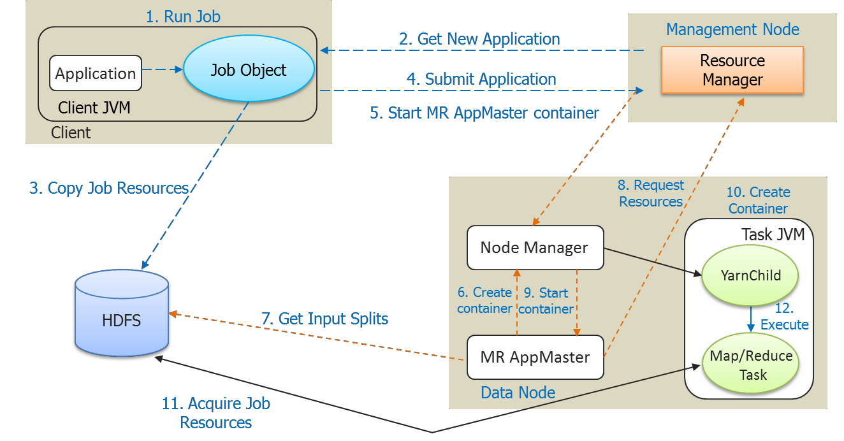
Let’s Revise
→ Traditional way Vs MapReduce way
→ Hadoop 2.x MapReduce Architecture and Components
→ YARN MR Application Execution Flow
Node 1
Node 2

Slide 54












Input Splits
HDFS
Blocks
Physical Division
INPUT DATA
Input Splits
Logical Division
Node 1
Node 2

Slide 55









Relation Between Input Splits and HDFS Blocks
Split
Split
Split
File Lines
1
2
3
4
5
6
7
8
9
10
11
Block
Boundary
Block
Boundary
Block
Boundary
Block
Boundary
→ Logical records do not fit neatly into the HDFS blocks.
→ Logical records are lines that cross the boundary of the blocks.
→ First split contains line 5 although it spans across blocks.
Node 1
Node 2

Slide 56



MapReduce Job Submission Flow
INPUT DATA
Node 1
Node 2
Input data is distributed to nodes
Node 1
Node 2

Slide 57



MapReduce Job Submission Flow
INPUT DATA
Node 1
Node 2
Input data is distributed to nodes
Each map task works on a “split” of data
Map
Map
Node 1
Node 2

Slide 58


MapReduce Job Submission Flow
INPUT DATA
Node 1
Node 2
Input data is distributed to nodes
Each map task works on a “split” of data
Map
Map
Mapper outputs intermediate data
Node 1
Node 2

Slide 59
MapReduce Job Submission Flow
INPUT DATA
Node 1
Node 2
Input data is distributed to nodes
Each map task works on a “split” of data
Map
Map
Mapper outputs intermediate data
Data exchange between nodes in a “shuffle” process
Node 1
Node 2

Slide 60








MapReduce Job Submission Flow
INPUT DATA
Node 1
Node 2
Input data is distributed to nodes
Each map task works on a “split” of data
Map
Map
Mapper outputs intermediate data
Data exchange between nodes in a “shuffle” process
Intermediate data of the same key goes to the same reducer
Reduce
Reduce
Node 1
Node 2

Slide 61


MapReduce Job Submission Flow
INPUT DATA
Node 1
Node 2
Input data is distributed to nodes
Each map task works on a “split” of data
Map
Map
Mapper outputs intermediate data
Data exchange between nodes in a “shuffle” process
Intermediate data of the same key goes to the same reducer
Reducer output is stored
Reduce
Reduce
Node 1
Node 2

Slide 62

Annie’s Question
MapReduce programming model provides a way for reducers to communicate with each other?
» Yes, reducers running on the same machine can
communicate with each other through shared memory
» No, each reducer runs independently and in isolation.

Slide 63
Annie’s Answer
Ans. No, reducers run independently and in isolation. Individual tasks do not know the input source. Reducer tasks rely on Hadoop framework to deliver the appropriate input for processing.

Slide 64
Annie’s Question
Splitting of a input file happens?
» randomly and decided by name node
» randomly and decided by job tracker
» line by Line and decided by Input Splitter
» we will have to specify explicitly

Slide 65
Annie’s Answer
Ans. Line by Line and decided by Input Splitter. Delimiters such as “,” , “:” etc. are used to decided the break points.

Slide 66
Demo of Input Splits

Slide 67




Overview of MapReduce
Complete view of MapReduce, illustrating combiners and partitioners in addition to Mappers and Reducers
MapReduce
Combiners
Partitioners
Combiners can be viewed as
‘mini-reducers’ in the Map phase.
Partitioners determine which reducer is responsible for a particular key.

Slide 68












Combiner – Local Reduce
COMBINERS
Mini-Reducers
Perform a “Local Reduce”
Passed workload further to the Reducers
Before we distribute the
mapper results

Slide 69























Combiner
B
(B,1)
Block 1
C D E D B
(C,1)
(D,1)
(E,1)
(D,1)
(B,2)
Combiner
(C,1)
(D,2)
(E,1)
Mapper
(A,2)
(C,2)
(D,4)
(E,1)
(A, [2])
Shuffle
(C, [1,1])
(D, [2,2])
Reducer
D
(D,1)
(E, [1])
Block 2
A A C B D
(A,1)
(D,2)
Mapper
(C,1)
(B,1)
(D,1)
Combiner
(C,1)
(B,1)

Slide 70
Annie’s Question
Combiner works at?
» Mapper Level
» Patitioner Level
» Reducer Level
» All the above

Slide 71
Annie’s Answer
Ans. Mapper level as Combiner works on the output data from Mapper.

Slide 72
Annie’s Question
Combiner can be considered as:
» Semi Partitioner
» Semi Reducer
» Semi Shuffler
» Major Reducer

Slide 73
Annie’s Answer
Ans. Semi Reducer. Combiner works on the Mapper
output and lessen the burden on Reducer.

Slide 74












Partitioner – Redirecting Output from Mapper
Map
Partitioner
Reducer
Map
Partitioner
Reducer
Map
Partitioner
Reducer

Slide 75
Annie’s Question
Can we use same logic for combiner and reducer?
» No, they are separate entities.
» Yes, only if reducer and combiner logic are commutative and associative and both of them are of same data types.

Slide 76
Annie’s Answer
Ans. Yes, you can use same logic if Reducer and Combiner logic are both commutative and associative and both of them are of same data types.

Slide 77
Annie’s Question
What is the role of ‘args’ variable in main method of Map Reduce program?
» Taking input and output from HDFS
» Taking input and output value from command line
» Taking path of input and output file from command line
» none of the above

Slide 78
Annie’s Answer
Ans. C. Taking path of input and output file from
command line.

Slide 79
Annie’s Question
Can we change the format of output key class and output value class?
» TRUE
» FALSE

Slide 80
Annie’s Answer
Ans. TRUE

Slide 81
Annie’s Question
Text in Map Reduce is:
» Data Type
» Predefined Class
» Predefined Interface
» none of the above

Slide 82
Annie’s Answer
Ans. Predefined Class

Slide 83
Demo: Combiner and Partitioner MR Code
Demo: Combiner and Partitioner

Slide 84
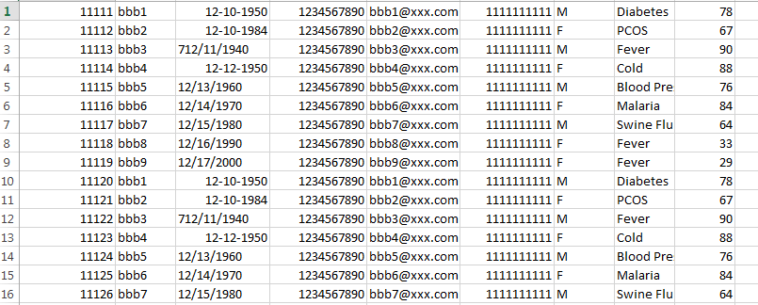
HealthCare Dataset

Slide 85









Revisit De-identification Architecture
Taking DB dump in CSV format
and ingest into HDFS
0100
1101
1001
Sqoop
matches
Store De-identified CSV file into HDFS
0100
1101
1001
HDFS
Read CSV file from HDFS
De-identify columns based on configurations
0100
1101
1001
Reduce Task 1
Reduce Task 2
.
.
Map Task 1
Map Task 2 .
.

Slide 86
DeIdentify MapReduce Code

Slide 87
DeIdentify MapReduce Code
static Logger logger = Logger.getLogger(DeIdentifyData.class.getName());
public static Integer[] encryptCol={2,3,4,5,6,8};
private static byte[] key1 = new String("samplekey1234567").getBytes();
public static class Map extends Mapper<Object, Text, NullWritable, Text> {
public void map(Object key, Text value, Context context) throws IOException, InterruptedException {
//value = PatientID, Name,DOB,Phone Number,Email_Address,SSN,Gender,Disease,weight StringTokenizer itr = new StringTokenizer(value.toString(),",");
List<Integer> list=new ArrayList<Integer>();
Collections.addAll(list, encryptCol);
//list=2,3,4,5,6,8 System.out.println("Mapper :: one :"+value); String newStr="";

Slide 88
DeIdentify MapReduce Code
int counter=1;
while (itr.hasMoreTokens()) {
String token=itr.nextToken(); System.out.println("token"+token); System.out.println("i="+counter);
if(list.contains(counter))
{
if(newStr.length()>0)
newStr+=",";
newStr+=encrypt(token, key1);
}
else
{
if(newStr.length()>0) newStr+=","; newStr+=token;
}
counter=counter+1;
}
output.collect( NullWritable.get(), new Text(newStr.toString()));
Slide 39
}
}
www.edureka.co/big-data-and-hadoop

Slide 89
DeIdentify MapReduce Code
public static void main(String[] args) throws Exception {
if (args.length != 2) {
System.out.println("usage: [input] [output]");
System.exit(-1);
}
Job job = Job.getInstance(new Configuration());
job.setOutputKeyClass(NullWritable.class); job.setOutputValueClass(Text.class);
job.setMapperClass(Map.class);
job.setInputFormatClass(TextInputFormat.class); job.setOutputFormatClass(TextOutputFormat.class);
FileInputFormat.setInputPaths(job, new Path(args[0]));
FileOutputFormat.setOutputPath(job, new Path(args[1]));
job.setJarByClass(DeIdentifyData.class);
job.waitForCompletion(true);
Slide 40
}
www.edureka.co/big-data-and-hadoop

Slide 90
DeIdentify MapReduce Code
public static String encrypt(String strToEncrypt, byte[] key)
{
try
{
Cipher cipher = Cipher.getInstance("AES/ECB/PKCS5Padding"); SecretKeySpec secretKey = new SecretKeySpec(key, "AES"); cipher.init(Cipher.ENCRYPT_MODE, secretKey);
String encryptedString = Base64.encodeBase64String(cipher.doFinal(strToEncrypt.getBytes())); return encryptedString.trim();
}
catch (Exception e)
{
logger.error("Error while encrypting", e);
}
return null;
}
}
www.edureka.co/big-data-and-hadoop

Slide 91
Demo of DeIdentify Program
www.edureka.co/big-data-and-hadoop

Slide 92


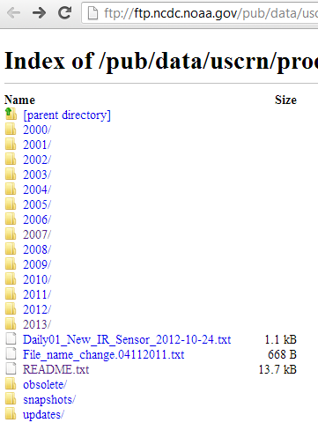
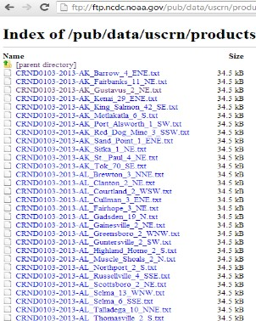
Weather Data
ftp://ftp.ncdc.noaa.gov/pub/data/uscrn/products/daily01/
www.edureka.co/big-data-and-hadoop

Slide 93
Demo of WeatherData Program
www.edureka.co/big-data-and-hadoop

Slide 94
MapReduce in Course Project
Demo: MapReduce in Project
www.edureka.co/big-data-and-hadoop

Slide 95











Flow Diagram
User Interface To search the top rated links per category
PIG
SQOOP
HIVE
HDFS
Huge Raw XML files
with unstructured
data line reviews
www.edureka.co/big-data-and-hadoop

Slide 96

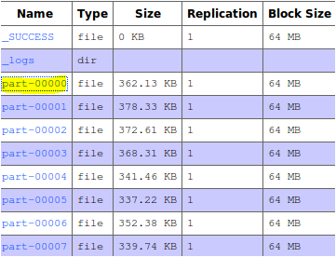

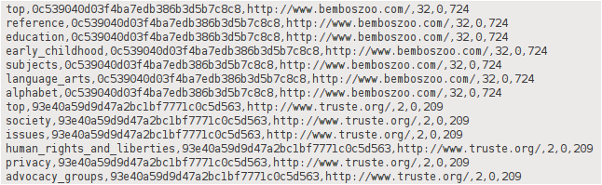
MapReduce Phase
Huge Raw XML files with unstructured data line reviews
Map Reduce
HDFS
Category
hash
url
+tive -tive total
www.edureka.co/big-data-and-hadoop

Slide 97


Assignment
Try Maximum Temperature problem in MapReduce
Try Hot and Cold day problem in MapReduce
www.edureka.co/big-data-and-hadoop

Slide 98

Pre-work
Run the codes discussed in the class
Complete the assignments
Read about Custom Input Format, Sequence Input Format, MRUnit
www.edureka.co/big-data-and-hadoop

Slide 99

Agenda for Next Class
→ Map and Reduce Side Join
→ Counters
→ Distributed Cache
→ Custom Input Format
→ Sequence Input Format
→ MRUnit
www.edureka.co/big-data-and-hadoop

Slide 100
Survey
Your feedback is important to us, be it a compliment, a suggestion or a complaint. It helps us to make
the course better!
Please spare few minutes to take the survey after the webinar.
www.edureka.co/big-data-and-hadoop

Slide 101

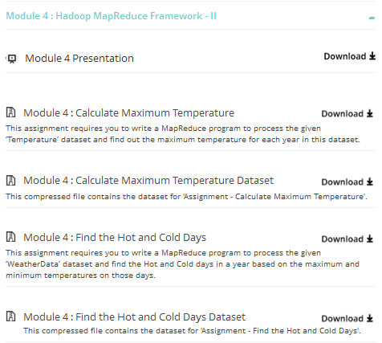
What’s within the LMS
Presentation
Assignment
and Dataset
www.edureka.co/big-data-and-hadoop

Slide 102


What’s within the LMS
Assignment
Solution
Pre-work
Quiz
www.edureka.co/big-data-and-hadoop

Slide 103
edureka !
/
•

Slide 104
Input Data (100
mb)
Hadoop Framework Sort
&
Shuffle
B1 –
64mb
Reduce
Task
MapTask
combiner
Final Out put
B2-
36mb
MapTask
combiner

Slide 105
Word Count Program Flow
 |  | B1
this is Hadoop Developer Training this is MR class.
 | MAP
 |  | B2
this class is practical based. welcome to this class.
 | MAP
 |  | B3
welcome to Hadoop learning
 | MAP
 |  | B4
Hadoop learning
 | MAP
(this,1)
(is,1) (Hadoop,1) (Developer,1) (Training,1) (this,1)
(is,1)
(MR,1)
(class,1)
(this,1)
(class,1)
(is,1) (practical,1) (based,1) (welcome,1) (to,1)
(this,1)
(class,1)
(welcome,1) (to,1) (Hadoop,1) (learning,1)
(Hadoop,1) (learning,1)
SORTING AND SHUFFLING BY HADOOP
this,[1,1,1,1]
Is,[1,1,1]
…… Hadoop,[1,1,1]
REDUCE
(this,4)
(is,3)
….. (Hadoop,3)

Slide 106
Word Count Program Flow
 |  | B1
this is Hadoop Developer Training this is MR class.
 | MAP
 |  | B2
this class is practical based. welcome to this class.
 | MAP
 |  | B3
welcome to Hadoop learning
 | MAP
 |  | B4
Hadoop learning
 | MAP
(this,1)
(is,1) (Hadoop,1) (Developer,1) (Training,1) (this,1)
(is,1)
(MR,1)
(class,1)
(this,1)
(class,1)
(is,1) (practical,1) (based,1) (welcome,1) (to,1)
(this,1)
(class,1)
(welcome,1) (to,1) (Hadoop,1) (learning,1)
(Hadoop,1) (learning,1)
Combiners
Combiners
(this,2)
(is,2) (Hadoop,1)
….
(this,2)
(class,2)
(is,1)
….
SORTING AND SHUFFLING BY HADOOP
this,[2,2]
Is,[2,1]
…… Hadoop,[1,1,1]

Slide 107
City-wise Temperature Data
Toronto, 20
Whitby, 25
New York, 22
Rome, 32
Toronto, 4
Rome, 33
New York, 18
Toronto, 12
Whitby, 27
Whitby, 22
Rome, 37
Toronto, 18
Rome, 33
New York, 32
Toronto, 20
Whitby, 20
New York, 33
Rome, 38 Toronto,32 Rome, 33
New York, 18
New York, 2
Rome, 30
Toronto, 4
Rome, 31
New York, 20
Toronto, 22
Whitby, 19
MAP
MAP
MAP
MAP
(Toronto, 20)
(Whitby, 25)
(New York, 22)
(Rome, 33)
(Toronto, 18)
(Whitby, 27)
(New York, 32)
(Rome, 37)
(Toronto, 32)
(Whitby, 20)
(New York, 33)
(Rome, 38)
(Toronto, 22)
(Whitby, 19)
(New York, 20)
(Rome, 31)
SORTING AND SHUFFLING BY HADOOP
(Toronto, [20,18,32,22])
(Whitby, [25,27,20,19])
(New York, [22,32,33,20])
(Rome, [33,37,38,31])
REDUCE
(Toronto, 32)
(Whitby, 27)
(New York, 33)
(Rome, 38)

Slide 108
Course Topics
Module 1
Module 6
Understanding Big Data
Hadoop Architecture
Analytics Using Hive
Understanding HIVE QL
Module 2
Module 7
Hadoop Cluster Configuration
Data Loading Techniques
Hadoop Project Environment
Advance Hive
NoSQL Databases and HBASE
Module 8
Module 3
Advance HBASE
Zookeeper Service
Hadoop Map-Reduce Framework
Programming in Map Reduce
Module 9
Module 4
Hadoop 2.0 – New Features
Programming in MRv2
Advance Map-Reduce
MR Unit Testing Framework
Module 10
Module 5
Apache Oozie
Real World Datasets and Analysis
Project Discussion
Analytics Using Pig
Understanding Pig Latin

Slide 109


Weather Data
ftp://ftp.ncdc.noaa.gov/pub/data/uscrn/products/daily01/

Slide 110
Solving the Problem with Map-Reduce
Taking DB dump in CSV format and ingest into HDFS
Sqoop
matches
Store De-identified
CSV file into HDFS
HDFS
Read CSV file from
HDFS
De-identify
Map Task 1 columns based on
Map Task 2 configurations
.
Reduce Task 1 Reduce Task 2
.
.
.

Slide 111
The Traditional Way
Split Data
grep
matches
Very Big Data
Split Data
grep
matches
cat
All matches
Split Data
:
Split Data
grep
matches
grep
matches

Slide 112
Map-Reduce Paradigm
The Overall Map-Reduce Word Count Process
Input
Splitting
Mapping
List(K2,V2)
Shuffling
K2,List(V2)
Bear, (1,1)
Reducing
Final Result
K1,V1
Deer Bear River
Bear, 2
Deer, 1
Bear, 1
River, 1
List(K3,V3)
Car, (1,1,1)
Car, 3
Bear, 2
Car, 3
Deer, 2
River, 2
Dear Bear River Car Car River Deer Car Bear
Car, 1
Car, 1
River, 1
Car Car River
Deer, (1,1)
Deer, 2
Deer Car Bear
Deer, 1
Car, 1
Bear, 1
River, (1,1)
River, 2

Slide 113
Anatomy of a Map-Reduce Program
Map:
Key
Value
(K1, V1)
List (K2, V2)
Reduce:
Map-Reduce
(K2, list (V2))
List (K3, V3)

Slide 114
Map-Reduce Way
R E D U C E
Very Big Data
M A P
Partitioning
Result
Function
:

Slide 115
Revisit De-identification Architecture
Taking DB dump in CSV format and ingest into HDFS
Sqoop
matches
Store de-identified
CSV file into HDFS
HDFS
Read CSV file from
HDFS
De-identify
Map Task 1 columns based on
Map Task 2 configurations
.
Reduce Task 1 Reduce Task 2
.
.
.

Slide 116

Why Map-Reduce?
Two biggest Advantages:
Taking processing to the data
Node
Processing data in parallel
a
b
M
ap Tas
_{k} c
Rack
Map Task HDFS Block
Data Center

Slide 117















Input Splits
HDFS
Blocks
Physical
Division
INPUT DATA
Input Splits
Logical Division

Slide 118










Relation Between Input Splits and HDFS Blocks
Split
Split
Split
File Lines
1
2
3
4
5
6
7
8
9
10
11
Block Boundary
Block Boundary
Block Boundary
Block Boundary
Logical records do not fit neatly into the HDFS blocks.
Logical records are lines that cross the boundary of the blocks.
First split contains line 5 although it spans across blocks.

Slide 119



















Map-Reduce Job Submission Flow
INPUT DATA
Node 1
Node 2
Input data is distributed to nodes
Map
Map
Each map task works on a “split” of data
Mapper outputs intermediate data Data exchange between nodes in a “shuffle” process Intermediate data of the same key goes to the same reducer
Reduce
Reduce
Reducer output is stored
Node 1
Node 2

Slide 120











Overview of Map-Reduce
Complete view of Map-Reduce, illustrating combiners and partitioners in addition to Mappers and Reducers
Map-Reduce
Combiners
Partitioners
Combiners can be viewed as ‘mini-reducers’ in the Map phase.
Partitioners determine which reducer is responsible for a particular key.

Slide 121


















Combiner – Local Reduce
COMBINERS
Mini-Reducers
Perform a “Local Reduce”
Passed workload further to the Reducers
Before we distribute the mapper results

Slide 122



















Combiner
B C D E D B
(B,1)
Block 1
(C,1)
(D,1)
(E,1)
(D,1)
(B,1)
(B,2)
Combiner
(C,1)
Mapper
(D,2)
(E,1)
(A, [2])
(A,2)
(B,3)
(C,2)
(D,4)
(E,1)
(B, [2,1])
(C, [1,1])
(D, [2,2])
Shuffle
Reducer
D A A C B D
(D,1)
(E, [1])
Block 2
(A,1)
(A,1)
(C,1)
(B,1)
(D,1)
(D,2)
Mapper
Combiner
(A,2)
(C,1)
(B,1)

Slide 123
























Partitioner – Redirecting Output from Mapper
Map
Partitioner
Reducer
Reducer
Map
Partitioner
Map
Partitioner
Reducer

Slide 124







Flow Diagram
User Interface To search the top rated links per category
PIG
SQOOP
HIVE
HDFS
Huge Raw XML files
with unstructured data line reviews

Slide 125


MapReduce Phase
Huge Raw XML files with unstructured data line reviews
Map Reduce
HDFS
Category
hash
url
+tive -tive total

Slide 126



Slide 1 www.edureka.in/hadoop

Slide 127
Course Topics
Module 1
Module 6
Understanding Big Data
Hadoop Architecture
Analytics using Hive
Understanding HIVE QL
Module 2
Module 7
Hadoop Cluster Configuration
Data loading Techniques
Hadoop Project Environment
Advance Hive
NoSQL Databases and HBASE
Module 3
Module 8
Hadoop MapReduce framework
Programming in Map Reduce
Advance HBASE
Zookeeper Service
Module 4
Module 9
Advance MapReduce
MRUnit testing framework
Hadoop 2.0 – New Features
Programming in MRv2
Module 5
Module 10
Analytics using Pig
Understanding Pig Latin
Apache Oozie
Real world Datasets and Analysis
Project Discussion

Slide 128
Topics for Today
Sequence Files
Distributed Cache
MRUnit testing framework
Hadoop Counters: Reporting Custom Metrics
Revision
Combiner and Partition functions
Joins: Map-side Vs. Reduce-side Joins
Hadoop Data Types
Configure Input and Output Data Types
Custom Data Types
Writables
Custom Key Types
Input Formats
Output Formats

Slide 129
Pre-Class Questions
Pre-Class Questions
www.edureka.in/hadoop-admin

Slide 130























Lets’s Revise
The MapReduce Paradigm
INPUT DATA
Input data is distributed to nodes
Node 1
Node 2
Each map task works on a “split” of data
Map
Map
Mapper outputs intermediate data
Data exchange between nodes in a “shuffle” process
Intermediate data of the same key goes to the same reducer
Reduce
Reduce
Reducer output is stored
Node 1
Node 2

Slide 131



Annie’s Question
Can you use the MapReduce algorithm to perform a relational join on two large tables sharing a key? Assume that the two tables are
formatted as comma-separated files in HDFS:
Yes
No
Hello There!!
My name Annie.
I love quizzes and puz and am he e make you guys think and
answer my questions.

Slide 132



Annie’s Answer
Yes using MapReduce Join Algorithms such as Map-side, Reduce-
side, and In-Memory join in MapReduce.

Slide 133


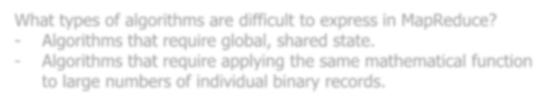
Annie’s Question
What types of algorithms are difficult to express in MapReduce?
Algorithms that require global, shared state.
Algorithms that require applying HtheellsoamTehmeareth!e!matical function
to large numbers of individua_{M}l b_{y}ina_{n}r_{a}y_{m}re_{e}cords_{A}. _{nnie.}
I love quizzes and puz and am he e make you guys think and
answer my questions.

Slide 134
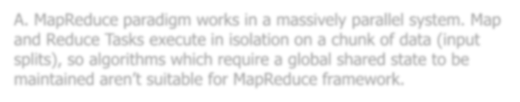
Annie’s Answer
A. MapReduce paradigm works in a massively parallel system. Map and Reduce Tasks execute in isolation on a chunk of data (input splits), so algorithms which require a global shared state to be maintained aren’t suitable for MapReduce framework.

Slide 135
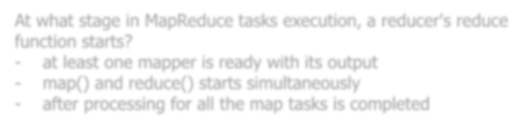
Annie’s Question
At what stage in MapReduce tasks execution, a reducer's reduce function starts?
-
at least one mapper is ready with_{H}i_{e}ts_{ll}o_{o}ut_{T}p_{h}ut_{ere!!}
map() and reduce() starts simultaneously
after processing for all the maMpytanskasmisecompAlentnedie.
I love quizzes and
puz and am he e make you guys think and
answer my questions.

Slide 136

Annie’s Answer
C. The Reduce tasks works on the output of Map tasks and the output from all the Mappers is required to start the Reduce process of MapReduce algorithm.

Slide 137



Annie’s Question
You want to reduce the traffic between mapper and reducer. Your class should implement which interface?
Partitioner
Combiner
Writable
WritableComparable
Hello There!!
My name Annie.
I love quizzes and puz and am he e make you guys think and
answer my questions.

Slide 138




Annie’s Answer
Combiner. Combiners are basically mini-reducers. They essentially lessen the workload which is passed on further to the reducers.

Slide 139











Combiner and Partitioner
Complete view of MapReduce, illustrating combiners and partitioners in addition to Mappers and Reducers
MapReduce
Combiners
Partitioners
Combiners can be viewed as ‘mini-reducers’ in the Map phase.
Partitioners determine which reducer is responsible for a particular key.

Slide 140
Demo: Combiner and Partitioner MR Code
Demo: Combiner and Partitioner
www.edureka.in/hadoop-admin

Slide 141









Map and Reduce Side Joins
Fragment (large table)
Map tasks:
Split 1
Split 2
Split 3
Split 4
Duplicate (small table)
Duplicate
http://www.edureka.in/blog/map-side-vs-join/

Slide 142
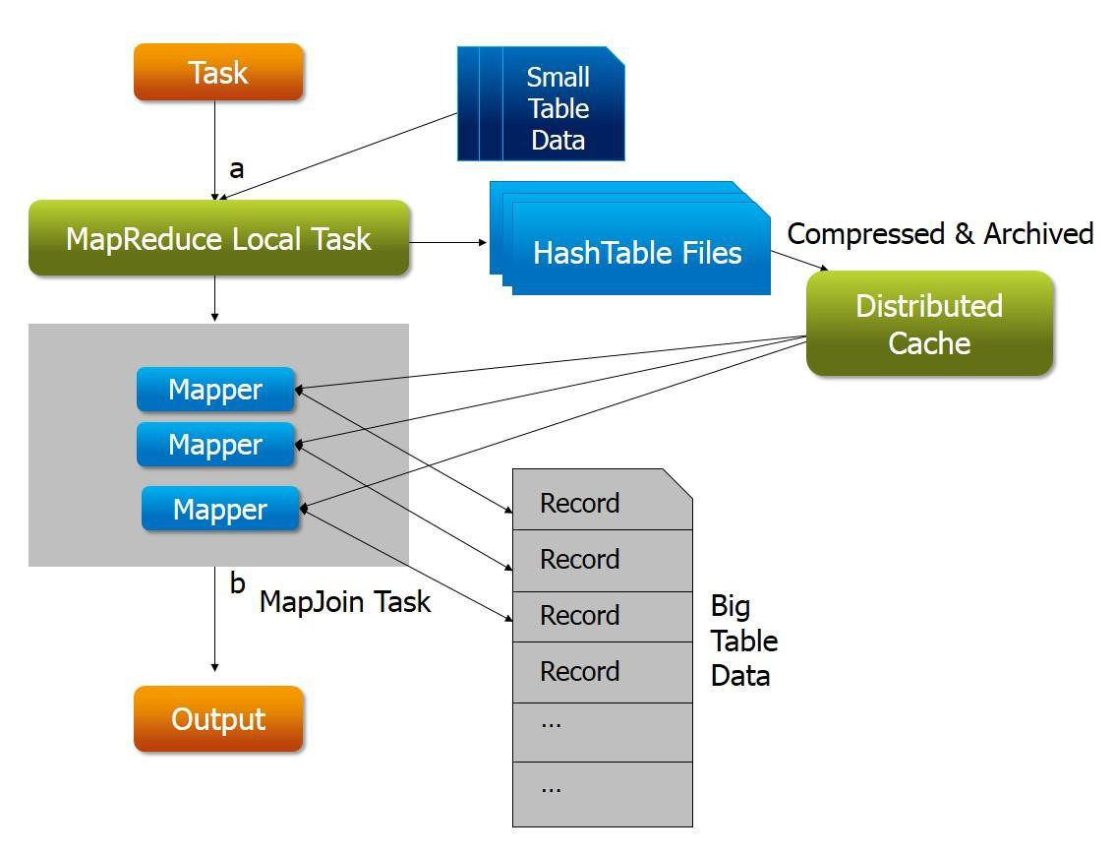
Map and Reduce Side Joins

Slide 143
Demo: Joins In MapReduce
Demo: Joins in MapReduce
www.edureka.in/hadoop-admin

Slide 144


Data Types
WritableComparable
base interface for keys
Writable
base class interface for values
Custom Data Types
www.ed
Slide 19
ureka.in/hadoop

Slide 145


















InputFormat
Input file
Input file
InputFormat
InputSplit
InputSplit
InputSplit
InputSplit
Record Reader
Record Reader
Record
Reader
Record Reader
Mapper
Mapper
Mapper
Mapper
(Intermediates)
(Intermediates)
(Intermediates)
(Intermediates)

Slide 146








InputFormat – Class Hierarchy
CombineFile InputFormat<K,V>
TextInputFormat
InputFormat<K,V>
org.apache. hadoop.mapreduce
FileInputFormat<K,V>
KeyValueTextInputFormat
NLineInputFormat
SequenceFileAs BinaryInputFormat
SequenceFile InputFormat<K,V>
<<interface>> Composable
SequenceFileAs TextInputFormat
CompositeInputFormat<K,V>
InputFormat<K,V>
SequenceFileInput
Filter<K,V>
DBInputFormat<T>

Slide 147













OutputFormat
Reducer
Reducer
Reducer
OutputFormat
RecordWriter
RecordWriter
RecordWriter
Output file
Output file
Output file

Slide 148







OutputFormat- Class Hierarchy
TextOutputFormat
<K,V>
SequenceFile OutputFormat<K,V>
OutputFormat<K,V>
org.apache.hadoop.mapreduce
FileOutputFormat
<K,V>
NullOutputFormat<K,V>
SequenceFileAsBinary OutputFormat
DBOutputFormat<K,V>
FilterOutputFormat<K,V>
LazyOutputFormat
<K,V>

Slide 149
Demo: Custom Input Format
Demo: Custom Input Format
www.edureka.in/hadoop-admin

Slide 150

Advance MapReduce – MRUnit testing framework
Provides 4 drivers for separately testing MapReduce code
MapDriver
ReduceDriver
MapReduceDriver
PipelineMapReduceDriver
Helps in filling the gap between MapReduce programs and JUnit*
Better control on log messages with JUnit Integration
*JUnit is a simple framework to write repeatable tests.
Slide 25

Slide 151
Demo: MRUnit testing framework
Demo: MRUnit testing framework
www.edureka.in/hadoop-admin

Slide 152
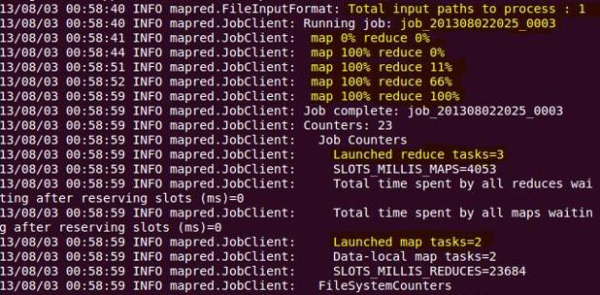

Advance MapReduce – Counters
Provides 4 drivers for separately testing MapReduce code
MapDriver
ReduceDriver
MapReduceDriver
PipelineMapReduceDriver
Helps in filling the gap between MapReduce programs and JUnit*
Better control on log messages
with JUnit Integration
Counters
Slide 27

Slide 153
Demo: Counters
Demo: Counters
www.edureka.in/hadoop-admin

Slide 154
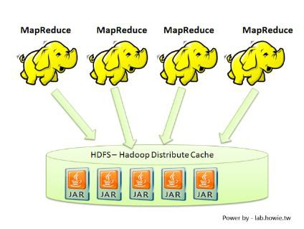
Distributed Cache
Cache applications specific files (text, archives, jars etc.) via the JobConf
Files are copied only once per job
Can cache archives which are un-archived on the slaves
Slide 29

Slide 155
Demo: Distributed Cache
Demo: Distributed Cache
www.edureka.in/hadoop-admin

Slide 156
SequenceFile
Flat file
Consist of binary Key/Value pair
Used in MapReduce as input/output formats
*Output of Maps are stored using SequenceFile
Provides
A Writer
A Reader
A Sorter
Three different SequenceFile formats:
Uncompressed key/value records
Record compressed key/value rec
Only ‘values’ are compressed here
Block compressed key/value records
Both keys and values are collected in ‘blocks’ separately and compressed

Slide 157






SequenceFile – Record Compression
Header | Record | Record | Sync | Record | Record | Record | Sync | Record
Block
compression
Record
length
Key length
Key
Value
4
4
Record compression
Record length
Key length
Key
Compressed Value
4
4

Slide 158



SequenceFile – Block Compression
Header
Sync
Block
Sync
Block
Sync
Block
Sync
Block
Block compression
Number of records
Compressed Key lengths
Compressed keys
Compressed value lengths
Compressed values
1-5

Slide 159
Demo: SequenceFile
Demo: SequenceFile
www.edureka.in/hadoop-admin

Slide 160
Module-5 Pre-work
Attempt the Advance MR Programs discussed in the class in your Hadoop setup
✓Review the following PIG blogs:
http://www.edureka.in/blog/apache-pig-installation-on-ubuntu/ http://www.edureka.in/blog/pig-programming-create-your-first-apache-pig-script/
Slide 35

Slide 161
Thank You
See You in Class Next Week

Slide 162
Hadoop Map Reduce

Slide 163
HDFS

Slide 164
Course Topics
Module 1
Module 6
Understanding Big Data
Hadoop Architecture
Analytics using Hive
Understanding HIVE QL
Module 2
Module 7
Hadoop Cluster Configuration
Data loading Techniques
Hadoop Project Environment
Advance Hive
NoSQL Databases and HBASE
Module 3
Module 8
Hadoop MapReduce framework
Programming in Map Reduce
Advance MapReduce
Advance HBASE
Zookeeper Service
Module 9
Module 5
Hadoop 2.0 – New Features
Programming in MRv2
Analytics using Pig
Understanding Pig Latin
Module 10
Apache Oozie
Real world Datasets and Analysis
Project Discussion

Slide 165
Advance MapReduce Contents
COUNTERS
DISTRIBUTED CACHE
JOINS – MAP-SIDE AND REDUCE-SIDE
CUSTOM INPUT FORMAT
SEQUENCE FILE FORMAT
MRUNIT TESTING

Slide 166
Counters
Counters are lightweight objects in Hadoop that allow you to keep track of system progress in both the map and reduce stages of processing.
You can see some of them each time you are running an hadoop job at the client console as MR dump.
By default, Hadoop defines a number of standard counters in "groups"; these also show up in the jobtracker webapp, giving you information such as "Map input records", "Map output records", etc.

Slide 167
Counters
Counters

Slide 168
Counters
Built In Counters In Hadoop
Hadoop provides some inbuilt counters for every job, for purposes like counting the number of records or bytes processed.
Map Reduce Task Counters - 'MAP_INPUT_RECORDS' which is used to count the number of input records read by each map task. The output is aggregated over all the tasks in a particular job.
Job Counters - By the JobTracker to collect statistics about the entire job. Example of this counter is 'TOTAL_LAUNCHED_MAPS' which is used to count the number of map tasks that were launched over the course of a job.

Slide 169
Counters
Custom Java Counters
Map Reduce allows users to specify their own counters for performing their own counting operation. A custom counter is defined by a Java enum, that groups related counters. The syntax for defining a Custom Counter is:-
enum MyCounter { MISSING,
TOTAL
}
where the counter MISSING is used to maintain the count of the missing records and the counter TOTAL is used to maintain the count of the total number of records . MyCounter represents the group of these two counters. A user can define any number of enums to group related counters.
Note:- Counters are global. The counter values are shared by all the map and reduce tasks across the
MapReduce framework and aggregated at the end of the job across all the tasks.

Slide 170
Counters
First you have to define an Enum which represents a group of counters.
public enum MyCounters { Good,Bad }
From within the map method of our mapper, we can access the counter and increment it when
we observe Good or Bad records.
context.getCounter(MyCounters.Good).increment(1);

Slide 171
Counters
Demo: Counters

Slide 172
Distributed Cache
Application may require some dependency/configuration/property files
A distributed spell-check application would require every Mapper to read in a copy of the dictionary.
Suppose for the processing of employee’s salary we need data on their grades which is available with another file .

Slide 173
Distributed Cache
Hadoop has the concept of a distributed cache which all task trackers (nodes) have access to.
When we want to distribute some common data across all task trackers we go for distributed cache.
The distributed cache can contain small data files needed for initialization or libraries of code that may need to be accessed on all nodes in the cluster.
DistributedCache is a facility provided by the Map-Reduce framework to cache files (text, archives, jars etc.) needed by applications.

Slide 174
Distributed Cache
Input data file
Tejas | Saravana | IT | up | 270000
Daniel | Hauge | HR | ma | 290000
Ajay | Bhosle | FIN | up | 270000
Swetha | Reddy | IT | wb | 129000
Martin | Alejandro | FIN | ma | 220000
Anitha | Joshi | HR | bi | 175000
Vivek | Rana | IT | bi | 270000
Fahad | Jafri | FIN | ma | 250000
To be cached
up ma bi wb
Uttar_Pradesh Maharashtra Bihar WestBengal
.......................
Suppose for the processing of employee’s records we need data on their detail location which is available with another file .

Slide 175
Distributed Cache
Use the DistributedCache.addCacheFile() method to add names of files which should be sent to all nodes on the system.
The file names are specified as URI objects; unless qualified otherwise, they assume that the file is present on the
HDFS in the path indicated.
When you want to retrieve files from the distributed cache (e.g., when the mapper is in its configure()step), use the DistributedCache.getLocalCacheFiles() method to retrieve the list of paths local to the current node for the cached files.
These are copies of all cached files, placed in the local file system of each worker machine. (They will be in a subdirectory of mapred.local.dir.)
In Driver class
try{
DistributedCache.addCacheFile(new
}catch(Exception e){ System.out.println(e);
}
URI("/state.dat"), job.getConfiguration());
In Mapper
Path[] files = DistributedCache.getLocalCacheFiles(context.getConfiguration());

Slide 176
Distributed Cache
Block1
Block2
HDFS
Employee
Block3
Block4

Slide 177
Distributed Cache
Block1 Task1
Block2 Task2
HDFS
Employee
Block3
Task3
Block4
Task4

Slide 178
Distributed Cache
Block1 Task1
 | DC File
Block2 Task2
 | DC File
HDFS
Employee
Block3 Task3
 | DC File
Block4
Task4
DC File

Slide 179
Distributed Cache
Demo: Distributed Cache

Slide 180
joins
MapReduce can perform joins between large datasets, but writing the code to do joins from scratch is fairly involved.
Rather than writing MapReduce programs, you might consider using a higher-level framework such as Pig, Hive, in which join operations are a core part of the implementation.
Map-side joins, as the name implies, read the data streams into the mapper and uses
logic within the mapper function to perform the join.
In contrast, a reduce-side join has the multiple data streams processed through the map
stage without performing any join logic and does the joining in the reduce stage.

Slide 181
Joins - Using the Distributed Cache

Slide 182
Joins
Demo: Joins in MapReduce
http://www.edureka.in/blog/map-side-vs-join/

Slide 183
Files, splits and records
Files will be physically split and kept as blocks in hdfs.
Logical inputSplit will be created as a part of the job startup and the data will be sent to the mapper implementation.
InputFormat class will provide how to split an input file into the splits required for map
processing.
InputFormat class will also create a RecordReader class that will generate the series of key/value pairs from a split.
The combination of the InputFormat and RecordReader classes therefore are all that is required to bridge between any kind of input data and the key/value pairs required by MapReduce.

Slide 184
Steps
Create Custom Key/Value Pair
Create Custom InputFormat
Create RecordReader
Implement Custom InputFormat in mapper
Define CustomInputFormat in Driver

Slide 185
Custom InputFormat
First define 2 custom WritableComparable classes. These classes represent the key-value pairs that are passed to the mapper, much as how TextInputFormat passes LongWritable and Text to the mapper.
To demonstrate how to create a custom WritableComparable, we shall write an implementation that represents a group of strings, called MyKey and MyValue.
Sample Data
===========
Key - Group of SensorType,timestamp,status
Value - Group of value1,value2
Sensor timestamp
Type
a b a
a
status
value1
value2
1386023259550
1389523259550
1386023259550
1389523259550
on off off on
22
33
44
34
23
34
43
24

Slide 186
WritableComparable
public void readFields(DataInput in) throws IOException{
value1.readFields(in); value2.readFields(in);
}
public void write(DataOutput out) throws IOException{ value1.write(out);
value2.write(out);
}
public int compareTo(Object o){
MyValue other = (MyValue)o;
int cmp = value1.compareTo(other.value1); if(cmp != 0){
return cmp;
}
return value2.compareTo(other.value2);
}
Define Text instance variables and associated constructors,
getters and setters .
write method serializes each Text object in turn to the output stream, by delegating to the Text objects themselves.
readFields() deserializes the bytes from the inputstream by delegating to each Text object.
compareTo() method that imposes the ordering you would
expect: it sorts by the first string followed by the second

Slide 187
InputFormat
Next, we need to create an InputFormat to serialize the text from our input file and create the MyKey and MyValue instances. This input format extends the Hadoop FileInputFormat class and returns our own implementation of a RecordReader:
public class MyInputFormat extends FileInputFormat<MyKey,MyValue> {
@Override
public RecordReader<MyKey, MyValue> createRecordReader(InputSplit arg0, TaskAttemptContext arg1) throws IOException, InterruptedException {
return new MyRecordReader();
}
}

Slide 188
MyRecordReader
Now, create a RecordReader to read from the input data file.
private MyKey key; private MyValue value;
private LineRecordReader reader = new LineRecordReader();
public void initialize(InputSplit is, TaskAttemptContext tac)
throws IOException, InterruptedException
{
reader.initialize(is, tac);
Text line = reader.getCurrentValue(); String[] tokens = line.toString().split("\t"); key.setSensorType(new Text(tokens[0])); key.setTimestamp(new Text(tokens[1])); key.setStatus(new Text(tokens[2])); value.setValue1(new Text(tokens[3])); value.setValue2(new Text(tokens[4]));
}
public boolean nextKeyValue() throws IOException, InterruptedException { boolean gotNextKeyValue = reader.nextKeyValue(); if(gotNextKeyValue){
if(key==null){
key = new MyKey();
}
if(value == null){
value = new MyValue();
}
}
else {
key = null; value = null;
}
return gotNextKeyValue;
}

Slide 189
Custom InputFormat
Finally, create a simple map-only job to test the InputFormat
public class MyFile {
public static void main(String[] args)
throws …… { Job job = new Job();
job.setJarByClass(MyFile.class); job.setJobName("CustomTest"); job.setNumReduceTasks(0); job.setMapperClass(MyMapper.class); job.setMapOutputKeyClass(Text.class); job.setMapOutputValueClass(Text.class); job.setInputFormatClass(MyInputFormat.class);
FileInputFormat.addInputPath(job, new Path(args[0])); FileOutputFormat.setOutputPath(job, new Path(args[1]));
job.waitForCompletion(true);
}
}
import org.apache.hadoop.io.Text;
import org.apache.hadoop.mapreduce.Mapper;
public class MyMapper extends Mapper<MyKey, MyValue, Text, Text> {
protected void map(MyKey key, MyValue value, Context context) throws java.io.IOException, InterruptedException {
String sensor = key.getSensorType().toString();
if(sensor.toLowerCase().equals("a")){ context.write(value.getValue1(),value.getValue2());
}
}
}

Slide 190
Demo: Custom Input Format

Slide 191
SequenceFile
Consist of binary Key/Value pair
Used in MapReduce as input/output formats
Output of Maps are stored using SequenceFile
The Sequence files have following advantages:
As binary files, they are intrinsically more compact than text files
They additionally support optional compression, which can also be applied at different levels, that is, compress each record or an entire split
The file can be split and processed in parallel
SequenceFiles have three compression options:
Uncompressed: Key-value pairs are stored uncompressed
Record compression: The value emitted from a mapper or reducer is compressed more compact than text files
Block compression: An entire block of key-value pairs is compressed

Slide 192
SequenceFile
Non splitable format
Most binary formats(compressed or encrypted) —cannot be split means that a single mapper will be used to process the entire file, causing a potentially large performance hit. In such a situation, it is preferable to either use a splitable format such as SequenceFile.
Too many small files
For example, a 10GB file broken up into files of size 100KB each, use a map of their own.
Thus the time taken to finish the job considerably increases.

Slide 193
SequenceFile
Demo: Sequence files

Slide 194
MRUnit
MRUnit is a unit testing framework designed specifically for Hadoop.
It began as an open source offering included in Cloudera’s distribution for Hadoop, and is now an Apache Incubator
project.
MRUnit is based on JUnit, and allows for the unit testing of mappers, reducers, and some limited integration
testing of the mapper-reducer interaction, along with combiners, custom counters, and partitioners.
It should be noted that MRUnit supports both the old (org.apache.hadoop.mapred) and new (org.apache.hadoop.mapreduce) MapReduce APIs.
Four types of tests provided by MRUnit:
A map test that only tests a map function (supported by the MapDriver class).
A reduce test that only tests a reduce function (supported by the ReduceDriver class).
A map and reduce test that tests both the map and reduce functions (supported by the MapReduceDriver class).
A pipeline test that allows a series of MapReduce functions to be exercised (supported by the TestPipelineMapReduceDriver class).

Slide 195
MRUnit
To write your test, you would do the following:
Instantiate the MapDriver class parameterized exactly as the mapper under test.
Add an instance of the mapper you are testing by using the withMapper call
The withInput call enables you to pass in a desired key and input value.
The expected output is specified using the withOutput call.
If a mapper is incrementing a counter, an optional .withCounter(group, name, expectedValue) enables you to specify the expected value of the counter.
The last call, runTest, feeds the specified input values into the mapper, and compares the actual output against the expected output set in the withOutput method.

Slide 196
MRUnit
The limitation of the MapDriver class is that you end up with a single input and output per test.
You can call withInput and withOutput multiple times if you want, but the MapDriver implementation will overwrite the existing values with the new ones, so you will only ever be testing with one input/output at any time.
To specify multiple inputs, you must use the MapReduceDriver object.

Slide 197
MRUnit
public void testReducer() throws Exception {
List<IntWritable> values = new ArrayList<IntWritable>(); values.add(new IntWritable(1));
values.add(new IntWritable(1));
new ReduceDriver<Text, IntWritable, Text, IntWritable>()
.withReducer(new WordCount.Reduce())
.withInput(new Text("cat"), values)
.withOutput(new Text("cat"), new IntWritable(2))
.runTest();
}

Slide 198
MRUnit
Following is a breakdown of what is happening in this code:
A list of IntWritable objects that are used as the input to the reducer is created.
A ReducerDriver is instantiated, it is parameterized exactly as the reducer under test.
An instance of the reducer you want to test is passed in using the withReducer call.
The withInput call enables you to pass in input values for a reducer.
You can specify the expected reducer output using the withOutput call.
If a reducer is incrementing a counter, an optional withCounter(group, name, expectedValue) enables you to specify the expected value of the counter.
7. Finally, you call runTest, which feeds the reducer the inputs specified, and compares the output from the reducer against the expected output.

Slide 199
MRUnit
MRUnit provides the MapReduceDriver class that enables you to test how a mapper and reducer are working together.
First, you parameterize the input and output types of the mapper, and the input and output types of the reducer. Because the mapper output types always match the reducer input types, you end up with three pairs of parameterized types.
Additionally, you can provide multiple inputs and specify multiple expected outputs.

Slide 200
MRUnit
public class MyMapperReducerTest {
MapDriver<LongWritable, Text, Text, IntWritable> mapDriver; ReduceDriver<Text, IntWritable, Text, IntWritable> reduceDriver;
MapReduceDriver<LongWritable, Text, Text, IntWritable, Text, IntWritable> mapReduceDriver;
public void setUp() {
MyMapper mapper = new MyMapper(); MyReducer reducer = new MyReducer();
mapDriver = MapDriver.newMapDriver(mapper); reduceDriver = ReduceDriver.newReduceDriver(reducer);
mapReduceDriver = MapReduceDriver.newMapReduceDriver(mapper, reducer);
}

Slide 201
MRUnit
//You can run separate Mapper and Reducer Test as follows
@Test
public void testMapper() {
mapDriver.withInput(new LongWritable(), new Text("6"));
mapDriver.withOutput(new Text("6"), new IntWritable(1)); mapDriver.runTest();
}
@Test
public void testReducer() {
List<IntWritable> values = new ArrayList<IntWritable>(); values.add(new IntWritable(1));
values.add(new IntWritable(1));
reduceDriver.withInput(new Text("6"), values);
reduceDriver.withOutput(new Text("6"), new IntWritable(2));
reduceDriver.runTest();
}
}

Slide 202
MRUnit
@Test
public void testMapReduce() throws Exception {
new MapReduceDriver<LongWritable, Text, Text, IntWritable, Text,IntWritable>()
.withMapper(new WordCount.Map())
.withReducer(new WordCount.Reduce())
.withConfiguration(new Configuration())
.withInput(new LongWritable(1), new Text("dog cat dog"))
.withInput(new LongWritable(2), new Text("cat mouse"))
.withOutput(new Text("cat"), new IntWritable(2))
.withOutput(new Text("dog"), new IntWritable(2))
.withOutput(new Text("mouse"), new IntWritable(1))
.runTest();
}
The MapReduceDriver class enables you to pass in multiple inputs that have different keys. Here, you are passing in two records — first with a LongWritable with an arbitrary value and a Text object that contains a line "dog cat dog", and second with a LongWritable with an arbitrary value and a Text object that contains the line "cat mouse".

Slide 203
MRUnit
PIPELINE TESTS
MRUnit supports testing a series of map and reduce functions—these are called pipeline tests.
You feed MRUnit one or more MapReduce functions, the inputs to the first map function, and the expected outputs of the last reduce function.
MRUnit has a few limitations:
The MapDriver and ReduceDriver support only a single key as input, which can make it more cumbersome to test map and reduce logic that requires multiple keys.
MRUnit isn’t integrated with unit test frameworks that provide rich error-reporting capabilities for quicker determination of errors.
The pipeline tests only work with the old MapReduce API, so MapReduce code that uses the new MapReduce API can’t be tested with the pipeline tests.
There’s no support for testing data serialization, or InputFormat, RecordReader, OutputFormat, or RecordWriter classes.

Slide 204
End

